Slide 1
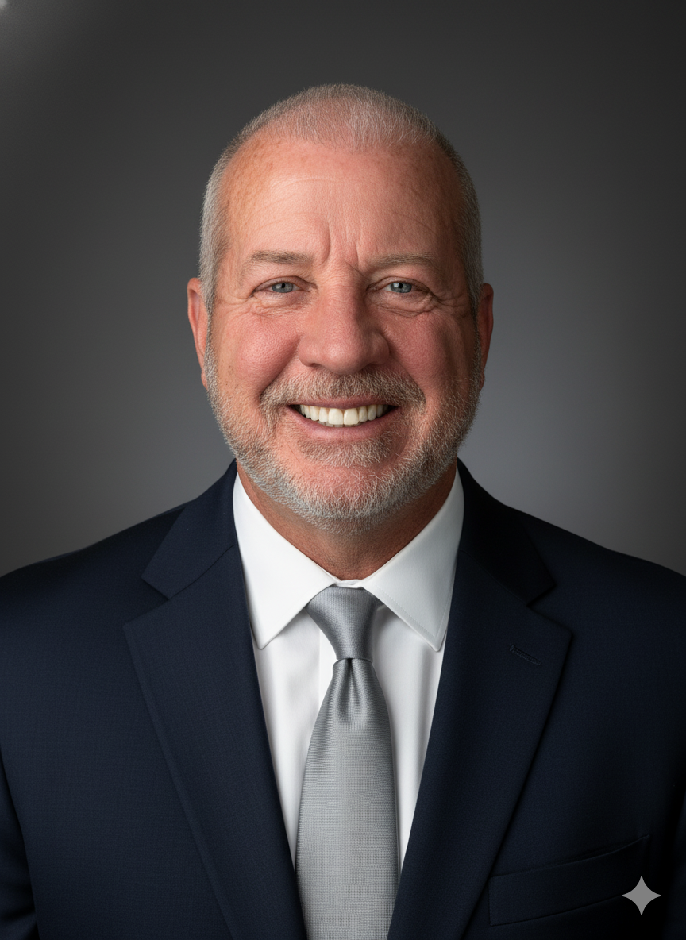
Ryan’s Story
A Father’s Hard-Earned Lessons about Cyberbullying and Suicide
Presented by John P. Halligan
Author and Motivational Speaker
Parents, please join us for
John Halligan’s son, Ryan, died by suicide after being bullied by classmates at school and online. He was only 13 years old.
Halligan’s presentation will cover the lessons learned too late for his family regarding how to deal with bullying, cyberbullying, and teen depression.
Please visit
RyansStory.org
Parents will be empowered with strategies to take preventive actions with their own children.
Please call XXXXXX. with any questions.
(000) 000-0000
January 1, 202X
7:00 PM - 8:00 PM
Location

